Slide 1

SCTP Based Interfaces
Notes:
SGSN-MME 14A Delta Training - Geographically Redundant Pool
2013-08-09
1
6/27/2019
1
6/27/2019
EAB/FBA/MP, Rev PA1
1

Slide 2
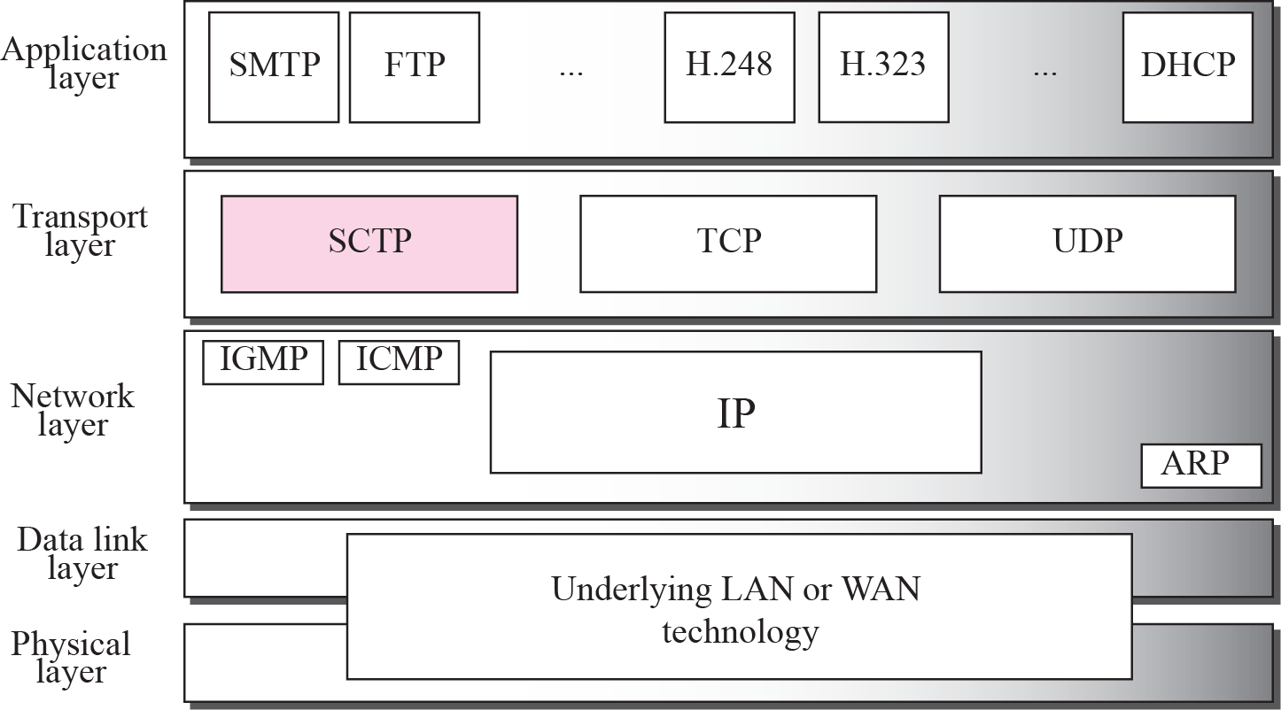
STREAM CONTROL TRANSMISSION PROTOCOL (SCTP)
Stream Control Transmission Protocol (SCTP) is a new reliable, message-oriented transport-layer protocol. Figure shows the relationship of SCTP to the other protocols in the Internet protocol suite. SCTP lies between the application layer and the network layer and serves as the intermediary between the application programs and the network operations.

Slide 3
BASIC SERVICES OFFERED BY SCTP :
Acknowledged error-free non-duplicated transfer of user data
Data fragmentation
Sequenced delivery of user messages
Bundling of multiple user messages into single SCTP packet
Fault tolerance
The design of SCTP includes appropriate congestion avoidance behavior and resistance to flooding and masquerade attacks.

Slide 4
SCTP USERS
SCTP is used by S1-AP
Diameter
SGsAP
MTP-L3 User AdSaptation (M3UA)
LCS-AP protocol layers

Slide 5
SCTP CONCEPTS
SCTP Association : Is a logical connection between two SCTP end points.
SCTP end point : Is the logical sender and receiver of SCTP packets.
STREAM : Is a sequence of user messages within a single SCTP
association
Multi-homing : An SCTP association is multihomed if it supports multiple ip
adresses at a given SCTP end point
SCTP client and : Is used for both client and server applications.
server
SCTP DATAGRAM : It is the unit of data that constitutes an SCTP message.Each datagram
consists of a common header followed by one or more chunks.

Slide 6
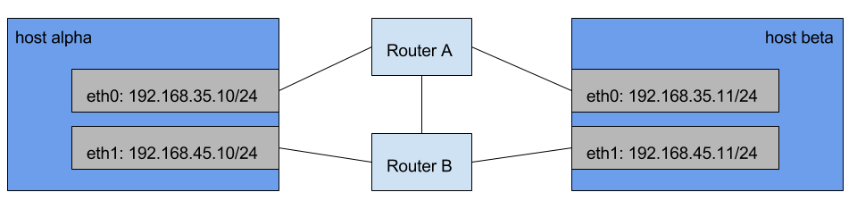
MULTI-HOMING
An SCTP endpoint is considered multi-homed if there are more than one transport address that can be used as a destination address to reach that endpoint.
For example in fig. host A and host B has got two routes between each other. With multi-homing you can add both paths to the association and in case of failure all the traffic will be transparently redirected to the other path.

Slide 7
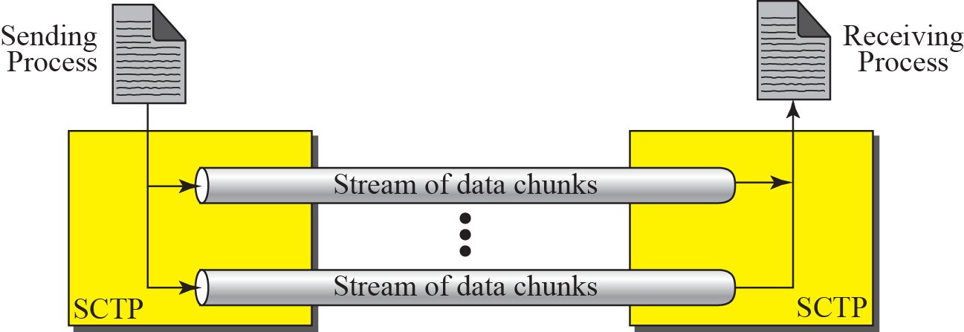
MULTIPLE-STREAM CONCEPT
If one of the streams is blocked,
the other streams can still deliver
their data.

Slide 8
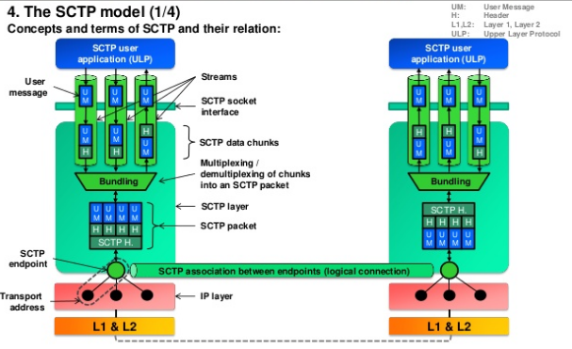
SCTP MODEL

Slide 9
SWITCHBACK MECHANISM
When the Switchback mechanism is enabled, the SCTP determines the Data Transfer Path (DTP) for outgoing traffic by counting heartbeats on the path. Initially, DTP is equal to the primary path. The primary path is the path selected at association establishment or later set by the operator through the action_sctp_sys_set_prim CLI command. When the primary path becomes unavailable, SCTP chooses the DTP for traffic from the set of available paths. After a configurable number of successful heartbeats on the primary path, the Switchback mechanism switches the DTP back to the primary path.
NO SWITCHBACK MODE
When No Switchback Mode is enabled, SCTP chooses another primary path only if the DTP fails. SCTP ignores the primary path, that is, SCTP selects the path that has the lowest error counter value as the next primary path. If several paths have equal error counter values, the fully divergent path is selected.

Slide 10
SCTP BASED INTERFACES
M3 Interface
S1-MME Interface
S6a Interface
S6d Interface
S13 Interface
SBc Interface
SGs Interface
SLg Interface
SLs Interface
Sx Interface

Slide 11
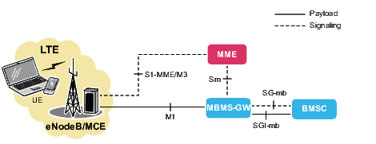
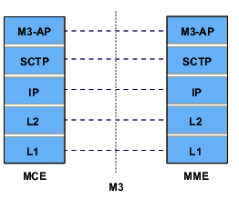
M3 INTERFACE
The M3 interface connects the SGSN-MME to the MCE. M3 Application Protocol (M3-AP) messages are transferred between the MME and the MCE
FEATURES :
The main feature of the M3 interface is the transport of M3-AP messages over the SCTP.
PROTOCOLS USED BY M3 :

Slide 12
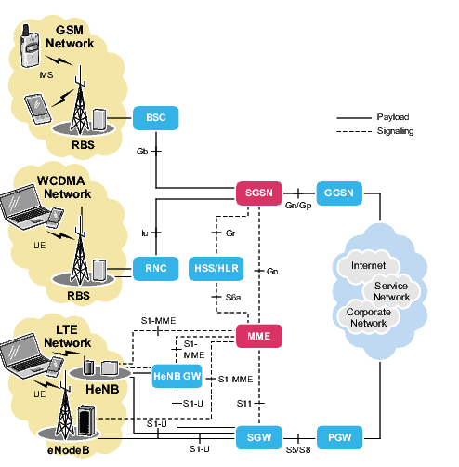
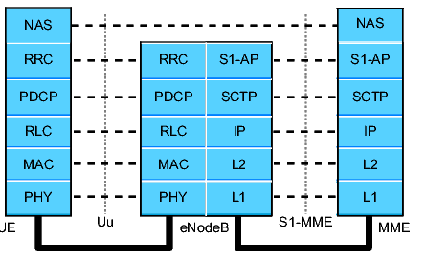
S1-MME INTERFACE
The S1-MME interface connects the SGSN-MME to eNodeBs (that are connected to UE). S1 Application Protocol (S1-AP) messages are transferred between the SGSN-MME and the eNodeB. NAS messages are transferred between the SGSN-MME and UE
The S1-MME interface has the following main features:
Transport of S1-AP messages over the SCTP
Transport of NAS messages over the S1-AP
The protocols used by the S1-MME interface :

Slide 13
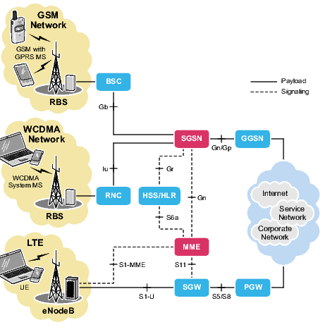
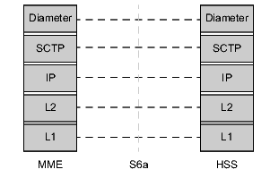
S6a INTERFACE
The S6a interface allows the HSS to keep track of UE locations and to provide the SGSN-MME with subscriber and authentication data. The SGSN-MME notifies the HSS if it autonomously de-registers a subscriber
PROTOCOLS STACK:

Slide 14
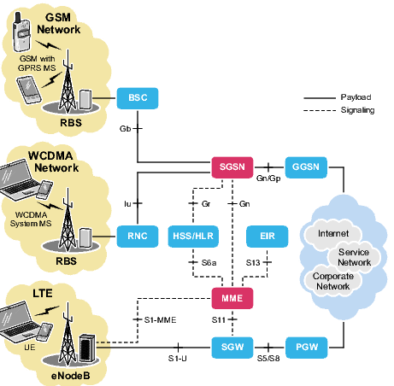
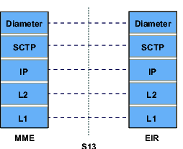
S13 INTERFACE
The S13 interface enables transfer of identity data for identification of ME and enables controlling the access for specific ME to the EPS network. This is done by the optional licensed feature IMEI Check
PROTOCOL STACK:

Slide 15
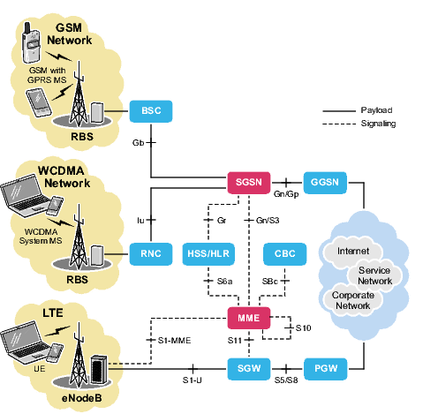
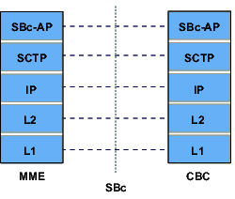
SBc INTERFACE
The SBc interface is an SCTP-based interface. It transfers SBc messages between the MME and the CBC.
PROTOCOL STACK:
The SBc Application Protocol (SBc-AP) is the application layer protocol between the MME and the CBC. The MME supports IPv4 and IPv6 on the SBc interface.

Slide 16
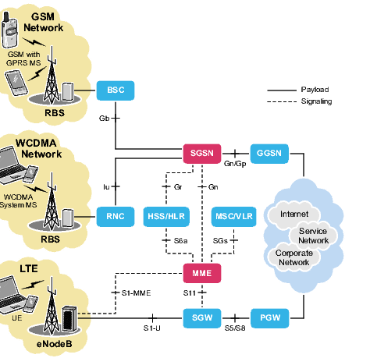
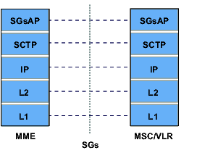
SGs INTERFACE
The SGs interface is a Stream Control Transmission Protocol (SCTP) based interface used for signaling between the SGSN-MME and the MSC/VLR.
PROTOCOL STACK:
The SGs Application Part (SGsAP) protocol sends messages over the SGs interface
The SCTP supports transferring of the SGsAP signaling messages.

Slide 17
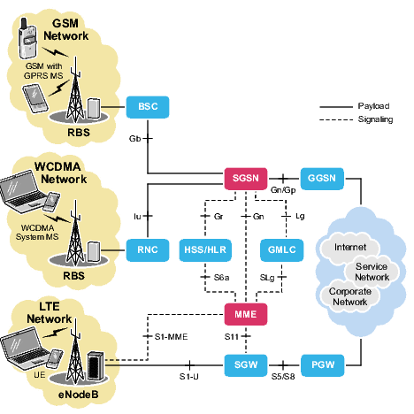
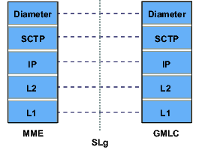
SLg INTERFACE
The SLg interface is a Diameter-based interface used for signaling between the MME and the GMLC
The SLg interface supports information transfer using IPv4 and IPv6.
PROTOCOL STACK:
A 3GPP vendor-specific Diameter application is used together with the Diameter base protocol to send messages over the SLg interface

Slide 18
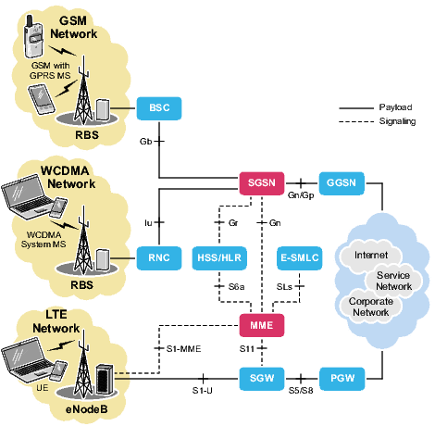
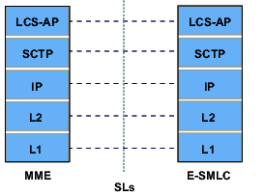
SLs INTERFACE
The SLs interface is a Stream Control Transmission Protocol (SCTP) based interface used for signaling between the SGSN-MME and the E-SMLC.
PROTOCOL STACK:
The Location Services Application Protocol (LCS-AP) is used for sending messages over the SLs interface
The SCTP supports transferring of the LCS-AP signaling messages

Slide 19
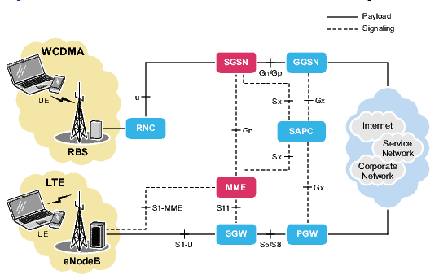
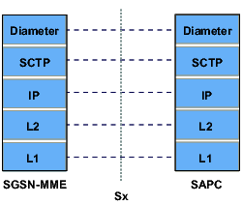
Sx Interface
Connecting the SGSN-MME to the SAPC, the Sx interface enables direct interconnection between the two, with the SGW and PGW or the GGSN bypassed. It enables the provisioning of policy data from the SAPC to the SGSN-MME and the transmission of user location information from the SGSN-MME to the SAPC.
PROTOCOL STACK:
A 3GPP vendor-specific Diameter application is used together with the Diameter protocol to send messages over the Sx interface.
SCTP is the transport protocol for the Sx interface
The Sx interface supports information transfer using IPv4 and IPv6.

Slide 20
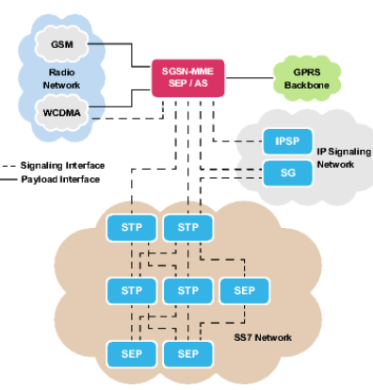
SS7
SS7 is a set of data links and protocols designed to transfer signals between nodes in telecommunication networks in a fast and reliable way.
SS7 is only used when the SGSN-MME is running as an SGSN. The MME does not use SS7 for signaling but use Stream Control Transmission Protocol (SCTP) and GTPv2-C instead.
Narrowband SS7 including High Speed Link (HSL) and SS7 over IP are supported on MkVIII hardware.
SS7 over IP is supported on MkX hardware
The combination of STPs, SEPs, and their signaling links form the SS7 network
For SS7 over IP, Signaling Processes are directly interconnected by Signaling Associations in the MTP-L3 User Adaptation Layer (M3UA) network.

